Slide 1
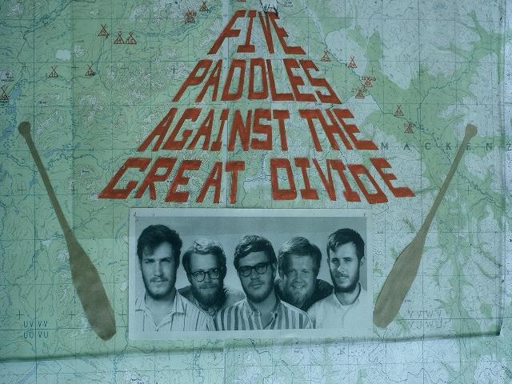
Notes:
This is about 5 guys just like many of the other guides at the Charles L. Sommers Wilderness Canoe Base who decided to test the skills they had learned against the wilderness of the Yukon and Northwest Territories
Left to right:
David Wolfe
Bruce Tannihill
Rolland White
Mark Wermanger
Bob Henry

Slide 2
Notes:
The basic goal is to travel from the U.S. to the Yukon Territory by motor transportation and then by canoe from a town called Ross River up over the Mackenzie Mountains divide between the Yukon and the Northwest territories and down to Great Slave Lake. Then, hopefully, someone would pick us up and back to the USA.

Slide 3
Notes:
The river systems to be navigated are:
The Ross River from the town of Ross River up to Christie Pass on the Mackenzie Mountain Divide which forms the border between the Yukon and NW Territories.
This parallels for the first few miles the old Canol road and pipeline. These are abandoned and run to Ft. Norman Wells near the Mackenzie delta. The road is now a Canadian heritage trail but still a very rough one.
The line and road were built during WW II by the 388th Engineer Battalion to transport oil from Ft. Norman Wells to support the war effort.
It soon leaves the Ross River valley and heads north, however.
The South Nahanni river from Christie Pass to its junction with the Laird River at Nahanni Butte. This is now a Canadian national park.
The Laird River to Ft. Simpson where the Laird enters the Mackenzie River.
The Mackenzie River to Ft. Providence near where it empties into Great Slave Lake.

Slide 4
Notes:
Some basic decisions had to be made initially.
Where? Bruce and Mark had been thinking about the Nahanni after having read about it and we decided to select this route.
How many Canoes?
It was decided that using one canoe on this route would run too high a risk of being damaged and stranded so it was determine we would take two.
Wood/Canvas were chosen to allow repair if damaged.
We decided on 5 people .
left enough people to paddle if someone was hurt, but still left room for all the food and gear that needed to be carried.
Past experience on long trips had resulted in people coming back in a two against one mode and we believe the larger number would help this situation.
Major planning took a year with meetings and going over air photos, maps, etc., planning menus, corresponding with individuals in the area, and developing gear and food lists.
Finally in the early summer we gathered in Fargo, N.D., to prepare for the trip.

Slide 5
Notes:
One of our first tasks was to make a supply of beef jerky which was to be our major meat source for the trip.
We cut thin slices, soaked them in curing salt brine and then hung them up to dry.
This was very attractive to flies and we tried to keep them off with a smudge from the BBQ, but as the meat dried in the sun they finally lost interest and left it alone.
There were many other tasks to include putting tumplines on packs, preparing poles, sorting all our gear and last minute checks before we proceeded to the canoe base for further gearing up.

Slide 6
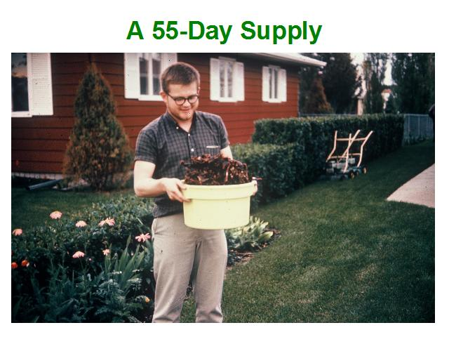
Notes:
Our work boiled down to the 55-day supply which looked small then and now.
Our hope was to supplement it during the trip with fish and maybe game.

Slide 7
Notes:
We traveled north to Ely and the canoe base on Moose Lake to pack our generously donated supplies.
Cliff Hanson
Michael Miler
Henry Bradlich
The guy who was the current guide chief, but whose name I can not, unfortunately, remember.
And Mark, Dave and Rolland

Slide 8
Notes:
Food was drawn, sorted and packed.
The bags were sewn by our mothers as part of the major support we received from our families.
This picture looks like the back of the mess hall, not the bay post.

Slide 9
Notes:
Almost all the food was from the basic stables list we were used to as guides at the base.
Our bagging philosophy was the same as that at the base, but with double plastic bags inside.
Plastic bags tied high and kept loose so they would not punch through.
Cloth bags were tied tight so they would provide protection against impact.
DID NOT LOSE ANY FOOD ON THE TRIP !!!!!
Among the basic philosophical principles were:
Eat rice once a day for breakfast or dinner. Very nutritious, hyperglycemic, and efficient to pack.
Bake our own bread from baking powder or a sourdough starter every evening for the next day.
Limited canned meat and the jerky & salami.
The lard, butter, PB & Jelly held up for the entire trip without going rancid in the screwed top containers. Jelly did ferment a little, but it jazzed up lunch.

Slide 10
Notes:
This is Bruce with our basic personnel kit for the trip.
Only the basics.

Slide 11
Notes:
Some key items on this list:
Dry shoes & socks are a key item to keep our feet in shape.
Suspenders to hold our pants up and belts to hold our knives and pliers,
Canvas pants for wear and wool shirts for warmth.

Slide 12
Notes:
As discussed before: Two 18‚Äù, wood and canvas canoes.
The Old town is very familiar to canoe base guides and people in the U.S. as a canoe made in Maine.
The Chestnut is a Canadian manufactured canoe that is a little wider and has a very rounded tumblehome. Now produced by the Petersburg Canoe Company.
Decided to go with standard Duluth A-3 packs including for food.
Modified the packs to add tumplines for easier carrying of heavy loads.
Selected square 8‚Äô x 8‚Äô tent with separate ground cloth.
Dining tarp will turn out to be one of the most useful items taken on the trip. More on this later.

Slide 13
Notes:
Axes will also turn out to be vital pieces of equipment for the trip as discussed later.
Cooking gear was all from canoe base.
Went with wire grate rather than poles and pot hooks because we had small pots (only 5 people) and fireplaces may be hard to build. Not enough rocks and a lot of work. Will not have fixed campsites.
First aid kit was very sophisticated including surgery gear. (In our young overconfidence) Barely used throughout the trip.
Canoe repair gear included canvas, Ambroid glue, some white lead paint.
We had a very basic radio transmitter to send an SOS but its effectiveness was extremely doubtful. We were basically on our own.

Slide 14
Notes:
Picked up a camper truck and trailer from Winibago from the Detroit Driver Service outlet in Iowa. Basically we were to deliver the campers to Fairbanks for the dealers there.
People are Bruce‚Äôs parents and sister (on the ground) and his fianc√©e along with Rolland and Bruce.
This gives you a good look at the canoes with the Old Town on the camper rack and the Chestnut on the ground.

Slide 15
Notes:
The Canadian portion of the Alcan highway is gravel because of the frost heaves that occur during the winter. The Alaskan portion is paved and has a lot of rough spots.
This is typical of the road in Canada.
On the way we were almost passed by our own trailer as one of the bumper struts became loose. We limped into one of the stops on the highway and a local repair man named Art Gordon welded it up for us. We averted what could have been a disastrous start.

Slide 16
Notes:
We traveled as a grout to the intersection of the Alcan Highway with the Canol Road at Johnson‚Äôs Crossing in the Yukon territory.
Bruce drove the campers on to Fairbanks while we prepared gear at Tislin Lake.
Bruce then returned via plane and hitchhiking.

Slide 17
Notes:
One of our constant companions during our wait for Bruce at Tislin Lake was a Husky that we affectionately dubbed Fang.
Having stolen some of our salami he hung around as confirmation of our skill as cooks and our choice of menus.

Slide 18
Notes:
While we were waiting we had some moccasins made for dry shoes by the local natives.
The commitment to change to dry shoes immediately at the end of each traveling day will result in none of us having any foot problems throughout the trip.
We had to leave the cabin because of the strong smell of smoked meat. A few weeks later we will be eating smoked fish that was much stronger and it will be a delicacy.

Slide 19
Notes:
A stop at Tislin Lake with Andy Smith, the Indian guide who took us from Johnson‚Äôs Crossing to Ross River in his pickup.
It was cold in the back and had gotten down to 29 degrees the night before.

Slide 20
Notes:
Our jumping off point was Ross River, Yukon, Territory. At the time it was a small community at the end of the portion of the Canol Road that could be driven.

Slide 21
Notes:
Prior to departing we visited with Fr. Riguard who had traveled the wilderness for about 14 years.
He had previously written us that ‚Äúhe would think of us when old Gus on the Nahanni found our bodies floating down the river.‚Äù He did not encourage us. He believed we could get up the Ross and over the divide if we were lucky, but that the Nahanni was to unpredictable for us to travel.
With the confidence of youth we, we completely disregarded his advice, and headed out for the divide.

Slide 22
Notes:
We took one last look at the map and departed civilization.
We Started out paddling against a fast current, but it would not last long.
Went to polling but had several accidents and it was slow going. We finally went to tracking with lines.
Even tracking has a learning curve in rapids and we had several accidents. Not really an auspicious start.

Slide 23
Notes:
A last look at civilization. The first 6 miles will be rapids.

Slide 24
Notes:
There was still some snow, even in this lower area of the Ross River. The water was cold and we often had to walk in it to get the canoes in deep enough water to travel.
Rapids can swamp you going up stream as well as down stream.
In the end the snow melt from further up the river kept the water high and made the travel in the upper reached possible.

Slide 25
Notes:
It is a long way from the Quetico and we were to spend very little time paddling in the next few weeks.
There are a lot of ways to move a canoe and we ended up using them all before the trip was over.

Slide 26
Notes:
The most basic way to move is to pull the canoe through the rapids and steady it.
It soon became clear that we were going to have to get used to being wet and in cold water.

Slide 27
Notes:
Many times it took several people to lift the canoes up through the falls and rapids, but we could not portage continuously with all the gear we had.

Slide 28
Notes:
The river had many different types of banks as shown here.
The rocky shores are flat and easiest to navigate, but the water was often too shallow so we had to walk in the water.
The other side in this picture is a shallow cut bank that is very hard to walk on and the fast water has built up many snags along the bank. Also, the trees go right up to the bank and make it difficult to walk on.
Ahead is a steep bank that we could walk along but the footing was difficult.
You can also see the trees built up on the bank that form barriers even on the rocky beach.
We often had to cross back and forth across the river. A big fight paddling to just hold our ground and cross.

Slide 29
Notes:
Often we had to wade through the alder bushes as the other bank was too steep and full of snags.

Slide 30
Notes:
The alders point downstream as they are swept that way by the current at high water and act like brush bristles to catch your line.

Slide 31
Notes:
This is a tracker‚Äôs eye view.
We soon learned to stow our gear better as we almost lost paddles and other gear when the canoes filled with water and almost swamped.

Slide 32
Notes:
The river smoothed out and we saw our first goal: Shelton Mountain.
Shelton lake near the mountain is about 100 miles from our start point.
We alternated between being able to walk on the bank and ion the water as the current was still too fast to paddle effectively.

Slide 33
Notes:
The other way we tried to travel was poling.
This is the classic poling stance.
We really never got the hang of it, but the poles made great tent poles.

Slide 34
Notes:
The bottom conditions varied.
Poles slip on rocks or get stuck between them.
Sometimes they stuck in the mud if we were closer to the cut banks.
Overall: Progress was just too slow.

Slide 35
Notes:
We had one swamp poling and nearly lost a canoe and our packs. We pretty much abandoned it.

Slide 36
Notes:
Our first major obstacle was Prevost Canyon where we portaged. We found an old trail to follow around the rapids.

Slide 37
Notes:
The reason for the portage.

Slide 38
Notes:
Prevost Canyon is beautiful but we were glad to see the end of it.
We camped on the point up ahead.

Slide 39
Notes:
After a few days of rain and a lot of water shipped walking the canoes through Prevost Canyon we take some time to dry things out.

Slide 40
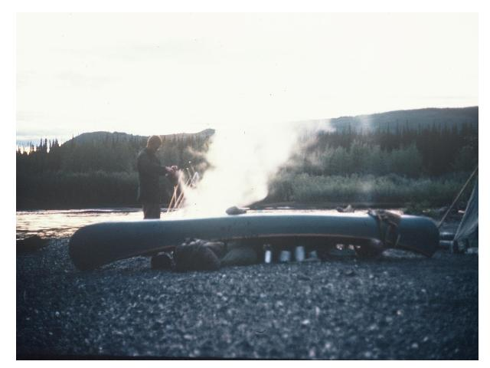
Notes:
Camp life goes on. Protecting gear under the canoes.
Finally some sunny days.

Slide 41
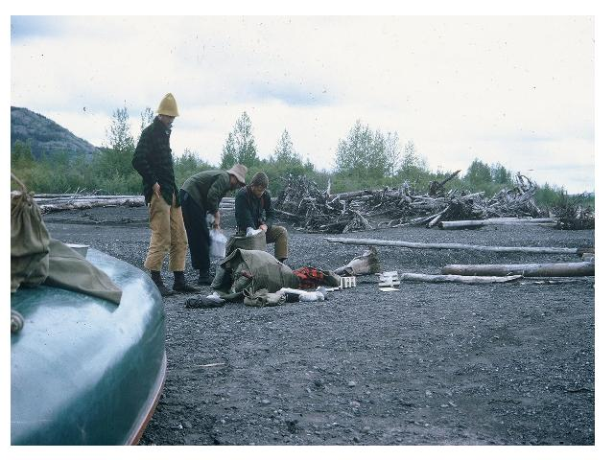
Notes:
Packing is an every day occurrence.
Part of the wisdom of having 5 identical food packs shows up as we only have to do three packs.
There was always plenty of driftwood for fires.

Slide 42
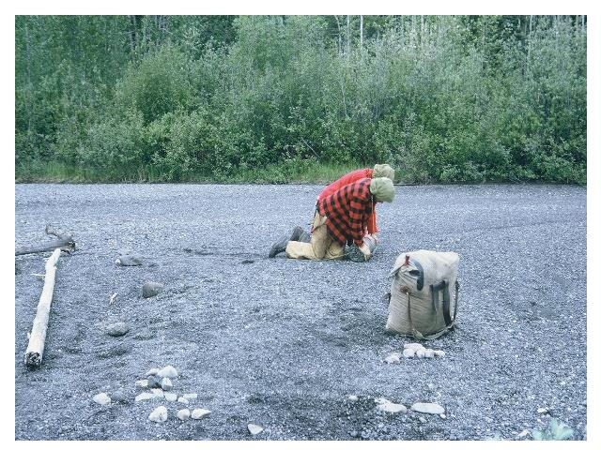
Notes:
Rolling up the tent every morning.
This is one of the personnel packs showing the tumpline.
Note the jackets --- it is still very cold.
Also note the mosquito netting on the hats. It was both a blessing and an interference as we tracked up river.

Slide 43
Notes:
This is typical of cooking and breakfast.
We also need to note the swollen hand. This was a continuing problem as our hands were alternately wet and dry as we tracked in the cold water.
Gloves kept the hands soft, but continually wet. When they dried out they cracked at the joints as they became chapped.
Rolland personally counted18 cracked joints on his hands. The others were similar.

Slide 44
Notes:
The mosquitoes were big but we learned to rub our face as we walked and keep them off.

Slide 45
Notes:
Slowly our bodies toughened and we gained strength (and lost fat).
We have already discussed the alternating wet and dry hands that left them chapped. They will not be fully cured until we lay over for a few days later at the Itsi lakes.
At night we clean dishes with sand and then one guy rinses them with a pliers in the lake so the others can keep their hands dry at night. We cut the grease with hot water before rinsing.
There were no foot problems on the trip because of our care to put on dry shoes and socks immediately each night. A strong confirmation of this policy.
We can see some mosquito nets on our heads. They didn‚Äôt work all that well. We were primarily concerned with black flies which take out chunks, but they did not turn out to be a problem as they are many places in the arctic tundra.

Slide 46
Notes:
We finally reach our first lake, Sheldon Lake, and can do some paddling.
This is Sheldon Mountain which towers above it.

Slide 47
Notes:
We camped near a cabin.
Hunters fly into this lake in sea planes with guides. We did it the hard way.

Slide 48
Notes:
After a little paddling time we contemplate the next leg of the trip to the Itsi lakes.

Slide 49
Notes:
We move through a series of small lakes and leave Mt. Sheldon behind.
Note the use of the tumpline.

Slide 50
Notes:
We go back to tracking in the river above Sheldon Lake.
The going is rough some times as the banks are covered with alders.
Note how the canoe is stern loaded to keep the bow up.

Slide 51
Notes:
Lunch is always a big occasion.
Note again how the canoe is back loaded. We learned to keep the bow up into the rapids but not too high or it whips around. The balance was something we learned for each canoe.

Slide 52
Notes:
We baked corn bread or bannock every night for the next day‚Äôs lunch.
Bannock and jelly, and how to divide 6 pieces 5 ways.
This was always a math problem as we lived in our socialist society.

Slide 53
Notes:
Soaking up the sun. Rest when you can get it.
Dave has never let us forget that he got up to take this picture.

Slide 54
Notes:
We look ahead to our next goal of the Itsi lakes at the base of the Itsi Mountains.

Slide 55
Notes:
More rough water and more portaging.

Slide 56
Notes:
We reach our next goal, the Itsi Lakes.
We will lay over here for three days to heal the hands and make repairs on gear.

Slide 57
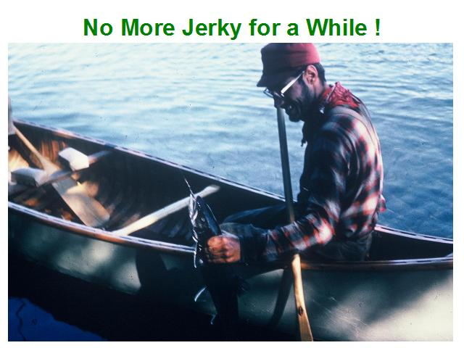
Notes:
Just as important we can do some fishing.
We did not have enough sinkers to get down for lake trout so we used some lead bullets from some shells that had gotten wet

Slide 58
Notes:
We had the first good fishing (and the time to do it here).
Bob and Dave caught 12 good sized lake trout.

Slide 59
Notes:
We ate 5 of the fish (about 20 pounds worth) for supper and filleted the rest for smoking.
Bruce made a rack out of sticks and we got a good smoky fire going.

Slide 60
Notes:
For one of many things in its useful life the dinning tarp was used to make the smoking tent.
The acetic acid in the smoke cures the fish.
We were to eat this for several days and it was strong and smoky, but unlike our memories smoked meat back at Johnson Crossing, this was a delicacy.

Slide 61
Notes:
The weather turned really nice and we had several days of healing. For the first time our hands became completely healed and our spirits were lifted as we were approaching the divide.

Slide 62
Notes:
While the rest of us worked on things in camp and just relaxed and recovered, Marc and Bruce climbed the foothills of the Itsi mountains and had this view of the lake and the Mackenzie Mountains.
They were rewarded for a had day of climbing by the site of a moose and a Dahl Sheep as well as the beautiful views of mountains and lakes.

Slide 63
Notes:
Rested and relaxed we headed out for the last lap to the divide.

Slide 64
Notes:
The river was not going to give up easily, and it was back to work in some rough water.
We were now in the portion of the river that was covered by some aierial photos we had been able to obtain and were happy to learn that the rapids were not a bad as they looked on the photos.

Slide 65
Notes:
We thought we saw some specs so we panned for gold at one of the stops, but we were not to become millionaires on the upper Ross River.
Note for Prospective Millionaires --- Mess kits don‚Äôt work very well for panning.

Slide 66
Notes:
As the water became shallower we again had the choice between the steep cut bank and wading in the water.
The current was very fast and lining was hard work as we waded in the water.
We had to cross the river by paddling many times as it snaked back and forth. Usually we could just hold our place and plane across. It was hard to make much upstream headway paddling.
As much as we hated the many gray and rainy days we had on the trip up the Ross, we were also lucky as this probably contributed to having plenty of water to reach the divide.

Slide 67
Notes:
Finally, studying the map and aerial photos we decided it was time to leave the river and portage over the divide as we looked up on Mt. Wilson.
We did not go to he headwaters of the Ross River, as the closed point to the headwaters of the Nahanni was below those headwaters.
The aerial photos were a great help in determining the right place to leave the Ross River.

Slide 68
Notes:
The portage itself turned out to be relatively flat after the climb up the rapids of the previous days.
We started the portage about noon after Marc had scouted it in the morning and made it to the other side about 6:00 p.m.
The portage was a mix of meadows, alter thickets, and shallow swampy ground. We believe our first stop was on the divide, and after that point we picked up a game trail that lead down to the first small lake on the Nahanni side.

Slide 69
Notes:
We did the portage in six segments.
We could not make a single carry and for each segment we left 3 packs behind with one person so we could be sure to find them again.
Fortunately we had used up a couple of food backs and could make each carry in two trips while still leaving someone behind and ahead.

Slide 70
Notes:
We finally break out on the lake that forms the headwaters of the Nahanni River.

Slide 71
Notes:
There are a few small lakes that form the headwaters of the Nahanni river.
We camped in a small meadow near a beaver dam that helps form the lakes.

Slide 72
Notes:
We dug out a package of Rootin-Tootin Raspberry we had been saving for the occasion and mixed it with lemon crystals. We heated it and drank a toast to the divide.
It was not rum, but the taste was just a sweet as we had accomplished our first two goals and made it up the Ross River and over the divide.
Whatever lay ahead (and there was a lot as you will see) this was sweet.

Slide 73
Notes:
We canceled a planned layover day since we were not successful in catching any fish .
The placid headwaters brought memories of the Quetico beaver streams.

Slide 74
Notes:
Again, the high water helped us at the divide and the upper reaches of the Nahanni.

Slide 75
Notes:
We are cautious and spend quite a bit of time portaging in the early going.
The river is beautiful, but rough and rocky.

Slide 76
Notes:
Reminiscent of the upper reaches of the Ross we spent much time walking the canoes through rapids.
The Nahanni is much more rocky than the Ross.

Slide 77
Notes:
As the river became wider and deeper we were able to spend more time running rapids. This raised our confidence and we were to pay for it soon.

Slide 78
Notes:
We spent more and more time running rapids.
You may notice that the last few pictures are of poor quality because of wet film. This is the result of the next few days. So is the lack of very many pictures of this part of the trip.
We scrape a lot of rocks, but things go well for a while.

Slide 79
Notes:
We finally pay the price of overconfidence.
While running a chute the Old Town starts to fill from rooster tails and slows down .
Running up behind the Chestnut almost runs it over and both capsize.
Rolland is in the water hanging on the stern of the canoe trying to flip it and stop it or guide it to shore when we hit a rock and the bottom bulges up in his face on the port tumblehome. The reaction as heard by Bob and Dave was ‚ÄúOh my God!‚Äù
Even worse we lose some paddles and end up with only three for the two canoes.
Mark saves a couple of packs from the Old Town by running down stream and leaving the Old Town on the far shore as he swam the river to catch the pack.
Two of or three cameras are wet when we unpack.
Rolland is voted best swimmer and gets to swim back across the river to get the Old Town. The 3/8‚Äù line attached to him as a ‚Äúlifeline‚Äù and to bring the canoe across almost drags him under.
Making it across we tie the line on the bow and with the help of a paddle from the other side are able to track the canoe across the river to our camp.

Slide 80
Notes:
We have two projects to get going again.
We split some partial ribs out of logs (about 2 ft long) and boil them in our big pot with another pot over the top. By alternating ends of boiling and continuous flexing we are able to install two partial ribs to hold in some slats that are placed at right angles to the ribs and tack them in. We brace them against the opposite gunnels . We also patch a small hole in the canvas.
Mark starts the construction of a paddle out of a log we have cut.

Slide 81
Notes:
There really was a paddle in there and it will be used by Mark the rest of the trip without mishap.
We set off again being a little more careful, but problems lurk in even simple areas as we will find out in one of the last little rapids before the river smoothes out.

Slide 82
Notes:
The water is much deeper and the chutes much easier to run.
Near the point where our air photos show the rapids end we are running an easy chute along the right side of the river.
The Chestnut runs it with no problem (we have learned to go it one at a time from the last problem).
The Old Town also runs the rough water with no problems but takes in some water from the rooster tails. It is drifting along in some fast current when it hits a deep rock with all the weight of the extra water in the canoe behind it.
The bottom is stove in with 12 ribs broken or cracked in three places and a rip in the canvas. Jelly bottom.

Slide 83
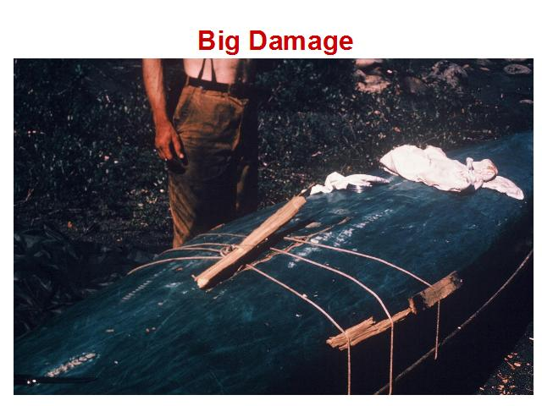
Notes:
We manage to pull the canoe back into shape but we need to hold it there and patch the major rip in the canvas.
The canvas is the easy part with canvas, and Ambroid glue plus some white lead paint.

Slide 84
Notes:
We decide to try to put new full ribs into the Old Town as the damage is much more extensive than what we had experienced with the Chestnut.
Our best friends become our axes and the dinning tarp.
We pick a green tree and split out ribs using the two axes and wooden wedges we carve.
The log has a quarter twist in it which we must follow so as to follow the fibers of the grain and not introduce weak spots that may break when we try to bend the ribs.
We trim them to width and thickness first with axes and then with our knives.

Slide 85
Notes:
The ribs will not bend enough to be used,
We tried to make a sauna to steam the ribs but it was not hot enough.
We finally have to dig a trench in the sand and line it with the dining tarp.
We pour in hot water and keep the water hot with white hot rocks from the fire in shifts over night.
In the end after trying with 11 ribs, we are able to get two ribs in the Chestnut and two in the Old Town, again to hold in planks across the broken ribs. We also get in some partials. They are rough and of limited flexiblity (which causes a few strange bulges in the canvas surface on the outside) but they are serviceable.
In all we will lay over here 6 days doing repairs and moose hunting.

Slide 86
Notes:
While the rest of the crew started working on the canoes, Bruce and Dave took the rifle and went hunting for meat.
After a long cold night and almost giving up they found a young bull moose which they were able to shoot.
They returned to camp exhausted hauling a moose quarter.

Slide 87
Notes:
While Dave and Bruce rested, Mark, Bob, and Rolland went back to the moose and collected as much as possible of what remained.
Rolland remembers this as more of a dissection than a butchering as the dental and pre-med student discussed muscles and connective tissue.
The team returned to camp with two packs of moose.

Slide 88
Notes:
The goal was to use as much of the moose as possible and not waste any of its sacrifice.
We gorged ourselves on fresh meat including the liver and the prime rib which we wrapped around a spit and roasted slowly.
This was to be the beginning of a change in our bodies culinary desires as we switched to a heavy protein diet with fewer starches to conserve our supplies.
We also worked to preserve what we could not eat by smoking some of the meat and making jerky out of some of it. We had carried some curing salt for just this reason.
The jerky was dried on the line as shown in the earlier slide.

Slide 89
Notes:
Once again the dining tarp was our best friend. And we made a smoking tent after we had completed bending the ribs.
Throughout the trip it would serve many uses, but at this site it and the axes were our most valuable tools.

Slide 90
Notes:
Instead of steadily declining in number as we ate, our number of packs now grew with the addition of a meat pack.

Slide 91
Notes:
With the canoes repaired and full of moose we reached the end of the upper river rapids and passed through the best of days as we swiftly moved down river with the current.

Slide 92
Notes:
This lady had nothing to fear from us as we disturbed her drinking.

Slide 93
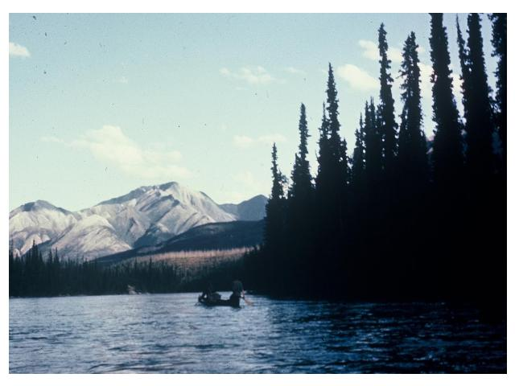
Notes:
We moved through the broad valley on clear water and in high spirits.

Slide 94
Notes:
The river continued to grow.
This tributary comes in from a burned area where there is more runoff, and the river becomes a little cloudy.
We travel until 8:30 and have made 45 miles today.

Slide 95
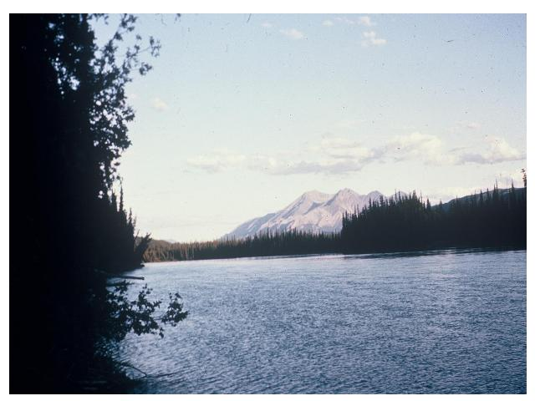
Notes:
The great life.
The Broken Skull River merges with the Nahanni. It is crystal green and clear and about 50% the size of the Nahanni.
We make another 46 miles.
We also see our first sign of civilization as a helicopter flies over us. It was probably quite a shock to them to see us.

Slide 96
Notes:
Along the way we take a climb to see Glacier Lake and its outfall into the Nahanni. The water is clear and cold as it comes off the still icy mountains.
Everyone‚Äôs disposition is good as the group gets along well and we have plenty to eat with the moose meat.

Slide 97
Notes:
While we don‚Äôt have time for fishing, we do find other contributions to our diet from mother nature.
We dine on blueberry pie and take a shot at making some jelly (of sorts) which starts to ferment a little later in the trip.

Slide 98
Notes:
We camped near the mouth of what turned out to be the smaller of the two branches of the Rabbit Kettle River near an old trappers camp site as more signs of civilization began to appear.
We took one of the canoes up the river to the Rabbit Kettle Hot
Springs which rose out of the forest as large calcium deposits from the spring water.
On the way we were able to shoot a spruce grouse for each of us with the 22 rifle and they made a nice fresh meal that night along with blueberry dumplings and blueberry muffins.

Slide 99
Notes:
The springs were shallow but we took the opportunity for a nice warm bath in the mineral water.

Slide 100
Notes:
We also took advantage of one of the pools to wash clothes..

Slide 101
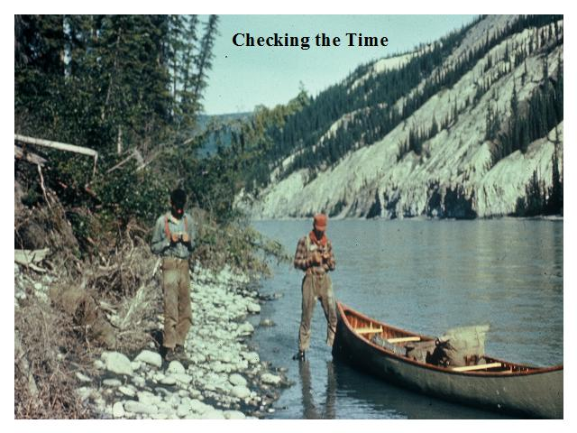
Notes:
For a number of days we settled into a pleasant routine.
TELLING TIME WITH OUR COMPASSES: We had no watches and went on the assumption that 6:00 was when the sun was in the east and the west respectively and noon when it was in the south. (also midnight in the north).

Slide 102
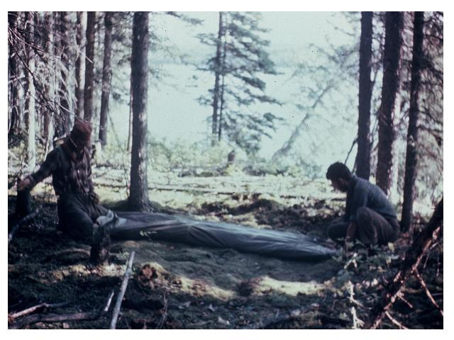
Notes:
Packing up the tent every morning.

Slide 103
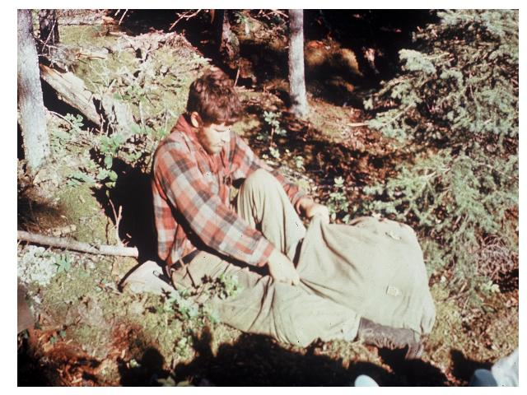
Notes:
Pushing down the sleeping bags and packing every day.

Slide 104
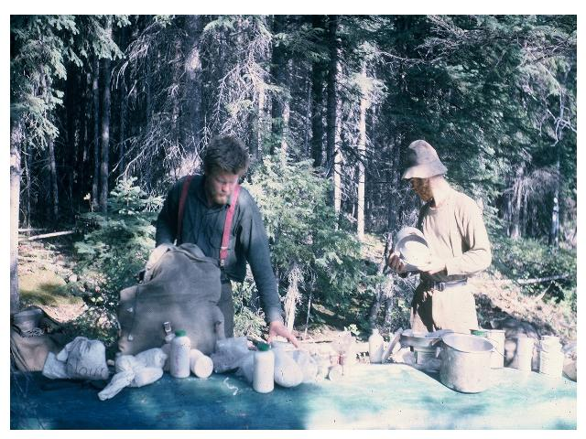
Notes:
Repacking the food/kettle packs.

Slide 105
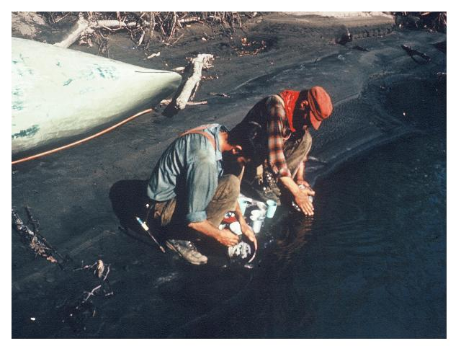
Notes:
And the inevitable washing the dishes.

Slide 106
Notes:
This is the good life with beautiful country and the river doing most of the work. There are still challenges ahead, but for now we can be content with the conquering of the divide and the upper Nahanni.

Slide 107
Notes:
Nothing is forever, however, and day 44 is the last of the idyllic wilderness days as we cautiously pick our way down the river toward Virginia Falls.

Slide 108
Notes:
On day 44 we reach Virginia Falls and the placid river begins the plunge into our next challenge --- the Nahanni canyon.
It also marks the change of other things. While we have seen signs of civilization for the entire trip, and particularly the last few days, we now meet our first people since we left Ross River.

Slide 109
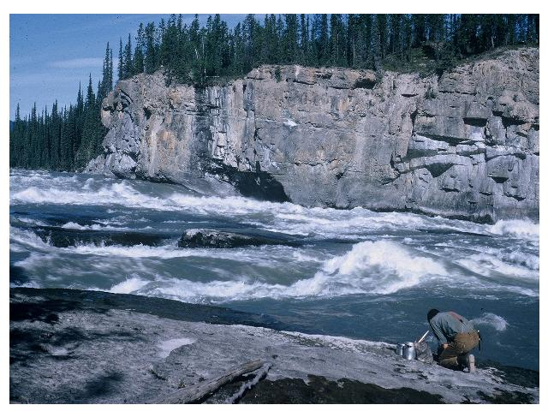
Notes:
We pitched camp on a bluff overlooking the rapids leading into the falls.
At the portage around the falls we met Don Turner and John Brucker , two hunting guides that were guiding a doctor from Atlanta looking for a Dahl Ram.
There were also many blueberries surrounding the camp so we picked a large batch and baked some pies which we shared with Don and John and the doctor who came over to our camp in the evening. Don and John had many interesting tales to tell of their lives in the northern wilderness.

Slide 110
Notes:
The rapids above the falls drop about 100 ft in a quarter mile.
The falls then plunge down into the Nahanni Canyon.
The portage was steep but not much more difficult than many in the Quetico.

Slide 111
Notes:
The last big drop is 294 ft.

Slide 112
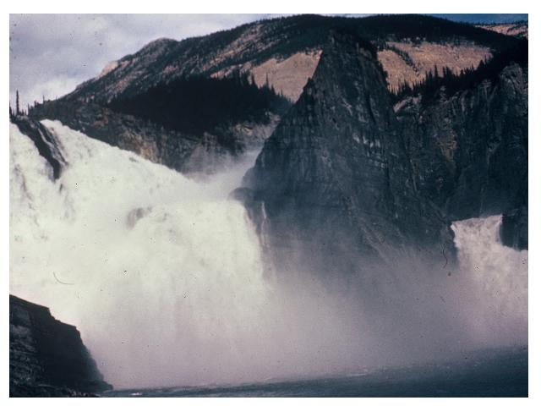
Notes:
The falls form a barrier that prevents travel further north for most parties.
The falls‚Äô width belies its height as its cascades around its central rock pillar.
We laid over at the falls in preparation for our last push down the river and on the 4th day we met a 5-man group from Mankato State who called themselves ‚ÄúThe American Expeditionary Society‚Äù, and had traveled up the river in motorized river boats, which were the normal means of travel on the lower Nahanni. Don and John were using a similar boat. Travel upstream in canoes would have been impossible.

Slide 113
Notes:
This picture shows the boat most people use with the twin outboard engines.
Everyone we met was better dressed than we were, but did not have our tale to tell of the trip over the divide.
We asked the guys from Mankato State to join us and the hunting group for pizza‚Äôs we were making and they brought some Biquick and lard to the party. (Our lard was still usable by the way). Since we were using their supplies Mark made two tins of blueberry bismarks which all enjoyed.
The Mankato State group then made a big mistake and challenged us to a pancake eating contest at their base camp down the river. More on that later.

Slide 114
Notes:
The river below the falls was rough with standing waves but we were able to run most of it as there was no choice --- no portages.
At one point the Old Town was stopped dead in a whirlpool and the Chestnut ran up over its gunnels swamping it. We were able to tow all ashore with the Chestnut after a struggle and had nothing worse to show for it than being all wet.
We were fortunate to be in an area where we could do that since it was not always possible as is illustrated by this picture.
For much of the canyon, we alternated sides of the river as we stayed on the inside of all the bends. The water here was shallow but the standing waves were low enough we could run them in a canoe. The standing waves at the outer wall were often 8 ‚Äì 10 feet high as they careened off the cliffs.

Slide 115
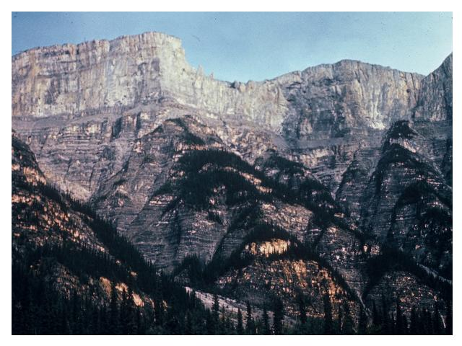
Notes:
The canyon was beautiful as it towered above us.
Walking out would not have been an option.
Unfortunately we were do not have a lot of pictures of the canyon because we were down to one camera and the river was a fast, rough run where we didn‚Äôt have much chance to stop and take pictures.

Slide 116
Notes:
Our next hazard was the Devil‚Äôs Gate where the river took a right angle turn as it ran straight into a cliff. This resulted in two whirlpools as the river split and washed back on itself. Obviously we portaged this, although they have to run it in the river boats.

Slide 117
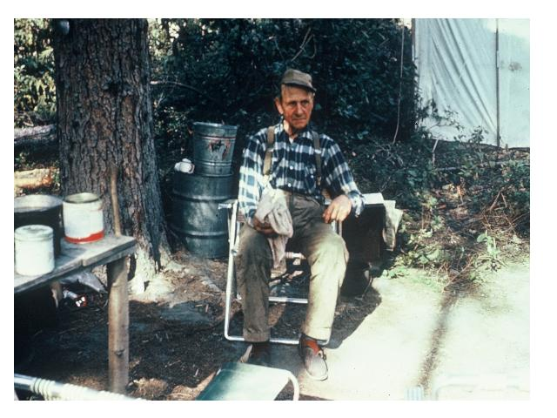
Notes:
The canyon widened out a bit and we came upon the camp of this gentleman ‚Äì Albert Failey‚Äì who is known as the old man of the river. He has been in the area for many years after he moved up from northern Minnesota. He was guiding some geologists that were doing research along the canyon
The group from Mankato State was also camped near here so we took the opportunity to take them up on their challenge to a pancake eating contest. Dave won with 44 and I was in 5th place with 31 (below the rest of our crew but above all the American Expeditionary Society whose champion stopped at 28). The obviously were not as starved for starch as we were.

Slide 118
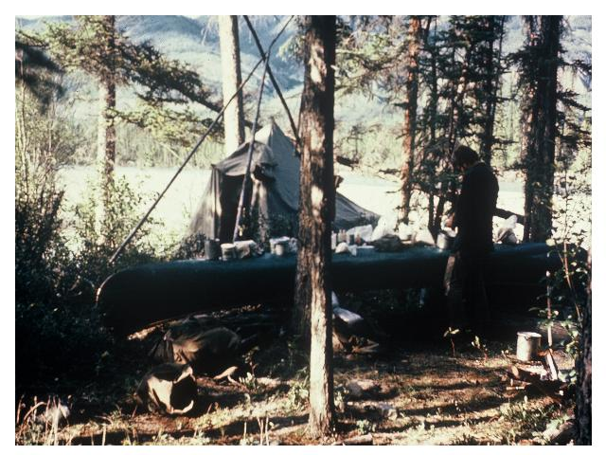
Notes:
In addition we cooked a big pot of beans and baked cakes. Dave and I had to stop 3 times and lay down as we walked the quarter mile back to batten down our camp when a squall appeared to be forming.
We had been cutting back on starch and eating a lot of protein (i.e., moose) and our bodies craved starches to the point where we would take turns licking the macaroni pot.
This is also the best illustration of a typical camp for us with the tent, kitchen table canoe, and fire grate.

Slide 119
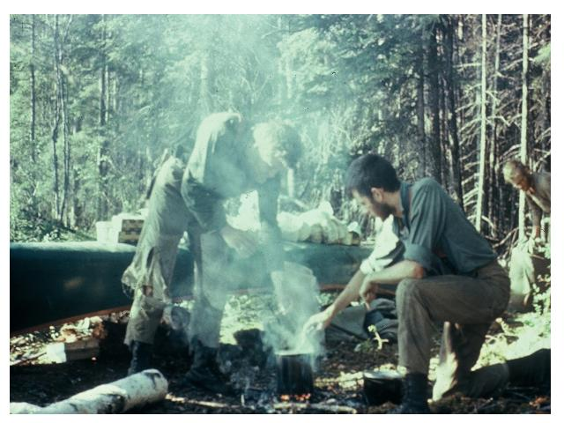
Notes:
Everyone became drunk with food as we ate excessive quantities of beans and moose with the other crew.
We staggered back to camp, hardly able to walk, and full of bean stew and it was a ripe night with 5 of us in the 8‚Äô x 8‚Äô tent.

Slide 120
Notes:
As the river tamed a little we made good time, but there were still some challenges ahead. Again, the width belies the height of the cliffs.

Slide 121
Notes:
Our next treat was to stop and visit with Gus Kraus who lived on the river year around with his native wife and a young boy they had adopted.
These are generous people and they had just receive a big shipment of fresh eggs. They cooked two dozen for us and gave us another dozen to take with us when we departed.
They also offered us some moose meat and when we declined saying we were fine he gave us a curious look and then smiled and said jokingly ‚ÄúI should probably shine up my badge some day.‚Äù He was the game warden for the river. We remained quiet.

Slide 122
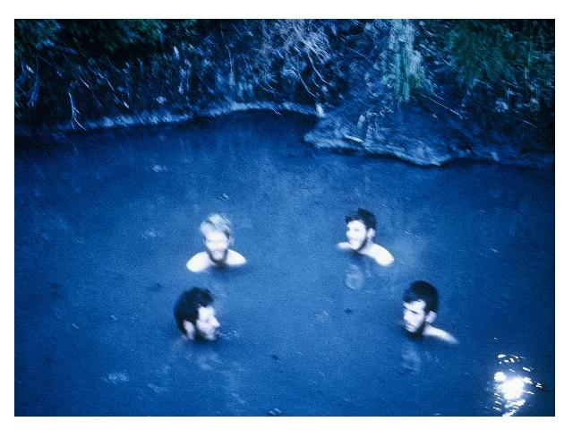
Notes:
Gus‚Äôs cabin is located in a valley with hot springs and we took the opportunity to take our second warm bath of the trip. The spring heats up in the winter as the cold water sources that dilute it freeze up.

Slide 123
Notes:
We must move on into the lower canyon and our last big obstacle called the chute.
The river makes a sharp oxbow around the rocky flat point shown here and swiftly moves down to a small rapid/fall of about 3 ft.
There are big standing waves on the outer shore of the bend and steep banks.
We needed to run down the swirls and eddies that formed along the inside shore staying far enough out to not run aground.
We then made a sharp turn to the right to run down a small chute at the far left end of the falls going downstream. The left side of this chute is a large boulder.
We were told we would be pushed against ‚Äúthe rock‚Äù and we were but there was no serious damage and we passed on into the rest of the lower canyon.

Slide 124
Notes:
The canyon finally broadened and with rough water the Nahanni emptied into the Liard River at a small settlement call Nahanni Butte.

Slide 125
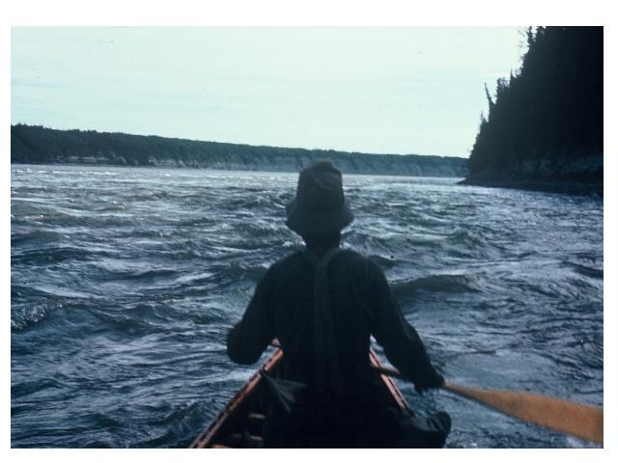
Notes:
The Liard was broad and rough at first.

Slide 126
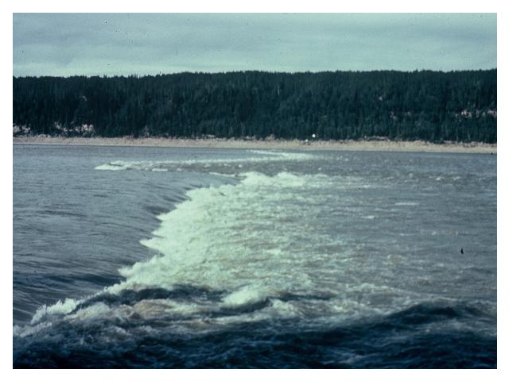
Notes:
We ran a series of rapids including this one called the beaver dam always keeping to the right shore.

Slide 127
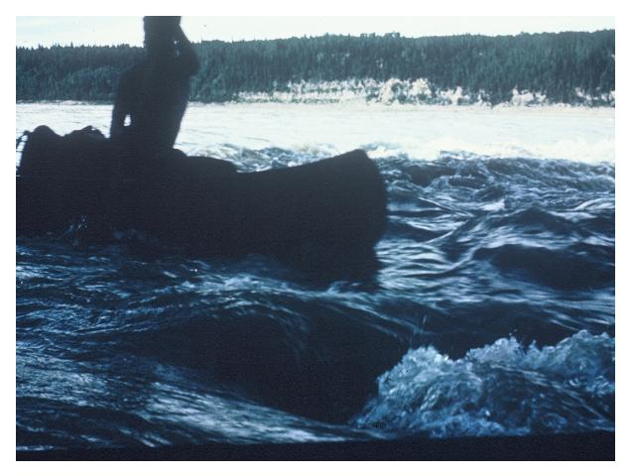
Notes:
We had a little bit of excitement as Dave and Rolland were almost impaled on a tree limb sticking out from the shore but the water shown here was more fun than dangerous as it was deep with few rocks.

Slide 128
Notes:
As things smoothed out we got lazy and tried sailing. Once again the tarp was our handiest tool.

Slide 129
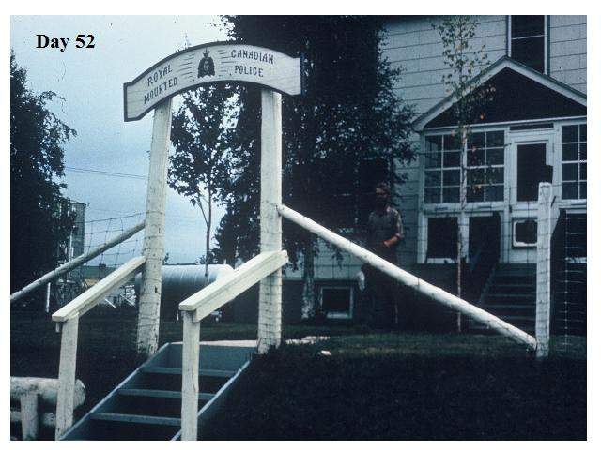
Notes:
We finally arrived as Ft. Simpson which is at the junction of the Laird and the Mackenzie rivers and reported in to the authorities that we were off the river.
We were warned by the Mounties that sometimes people who come out of the bush get a little rowdy. We are not sure exactly what they thought of us except maybe relief they didn‚Äôt have to come looking for us.
We also called home, told Bruce‚Äôs dad when we would be at Ft. Providence so he could pick us up, and, of course, asked our parents to wire money.

Slide 130
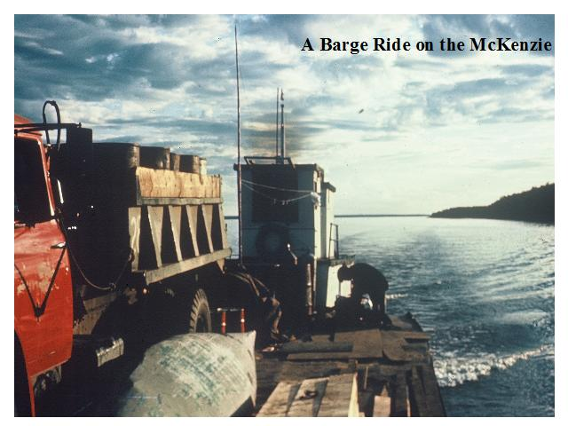
Notes:
We were fortunate to catch the weekly barge from Ft. Simpson to Ft. Providence and save ourselves what could have been a hard week of paddling against the current of the Mackenzie River.

Slide 131
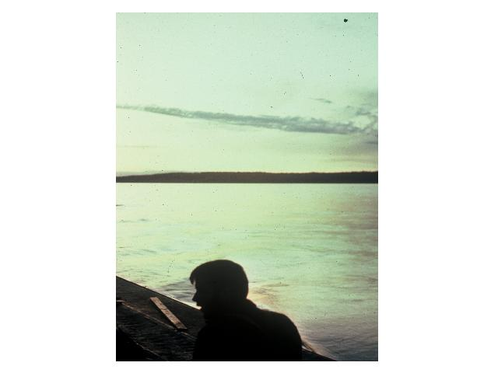
Notes:
We relaxed and told tales as the barge moved up the river.

Slide 132
Notes:
We took our last views of the midnight sun.

Slide 133
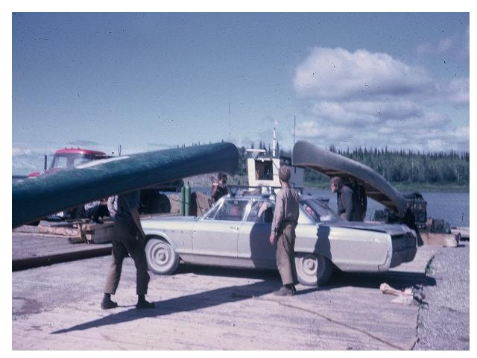
Notes:
At Ft. Providence we loaded two canoes, the five of us and Bruce‚Äôs dad and our remaining gear in a Buick and headed for home. Quite a load but cars were tough in those days.
Note the patch on the Old Town.

Slide 134
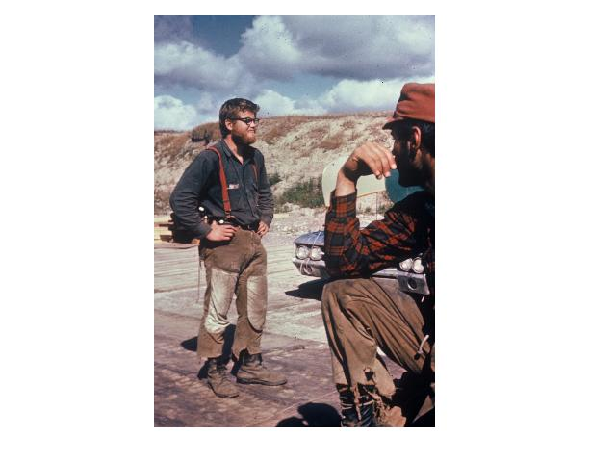
Notes:
Mark was proud of those pants

Slide 135
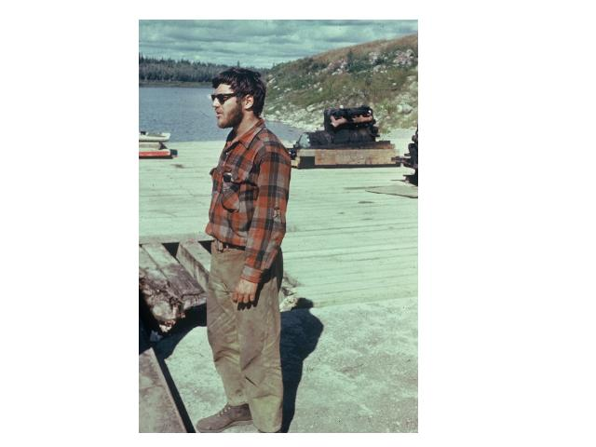
Notes:
Joe Cool.

Slide 136
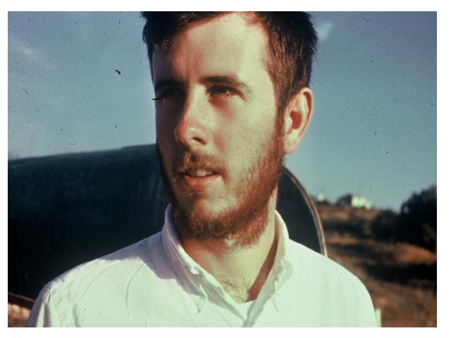
Notes:
Bob cleans up good.

Slide 137
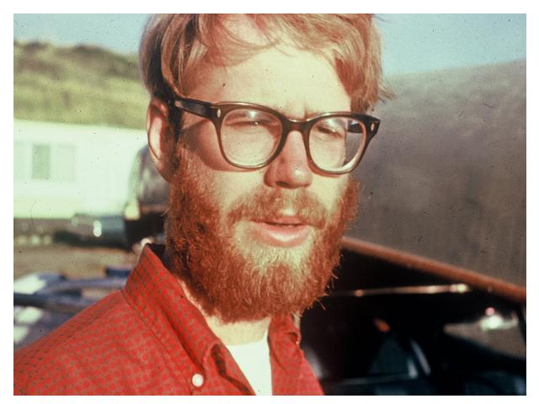
Notes:
So does Bruce.

Slide 138
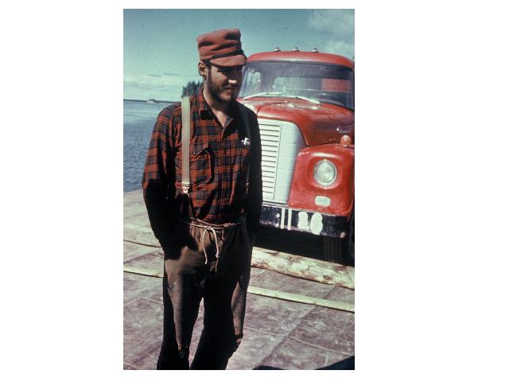
Notes:
Dave shows off his belt.

Slide 139
Notes:
We stop and take a look at our goal --- Great Slave Lake. Sad that the trip is over but glad to be heading home.

Slide 140
Notes:
This trip was over 40 years ago. It was based on the woodcraft that has been passed on over the years through each generation of guides.
Being a guide is part of a long tradition that goes back far before this trip. You are and individual, but also a member of the fraternity of Charlie‚Äôs guides. It is up to each of you to carry on the character, knowledge and woodcraft that are part of that long tradition and the long line of men that have come before you.
Look to your left and right. Don‚Äôt let these guys (your friends and peers) down.

Slide 141
Notes:
This trip was over 40 years ago. It was based on the woodcraft that has been passed on over the years through each generation of guides.
Being a guide is part of a long tradition that goes back far before this trip. You are and individual, but also a member of the fraternity of Charlie‚Äôs guides. It is up to each of you to carry on the character, knowledge and woodcraft that are part of that long tradition and the long line of men that have come before you.
Look to your left and right. Don‚Äôt let these guys (your friends and peers) down.

